Slide 1

Operating Systems Lab
Lab 03
National University of Computer and Emerging Sciences, Islamabad
Javeria.zia@nu.edu.pk

Slide 2
Steps in writing bash script
Write a script file using vi:
The first line identifies the file as a bash script.
#!/bin/bash
Comments begin with a # and end at the end of the line.
give the user (and others, if (s)he wishes) permission to execute it.
chmod +x filename
Run from local dir
./filename
Run with a trace – echo commands after expansion
bash –x ./filename

Slide 3
Variables
Create a variable.
Variablename=value (no spaces, no $)
read variablename (no $)
Access variable’s value.
$variablename
Set variable’s value
Variablename=value (no spaces, no $ before variablename)

Slide 4
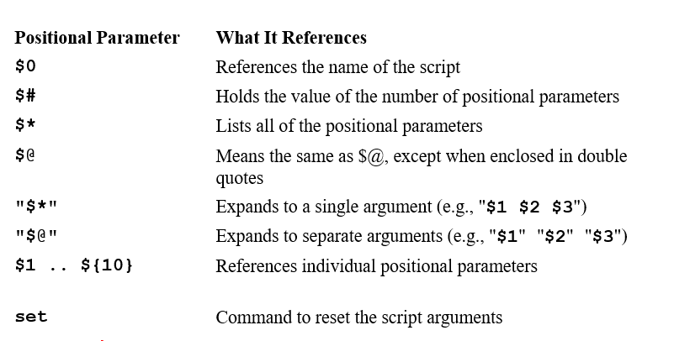
Positional parameters

Slide 5
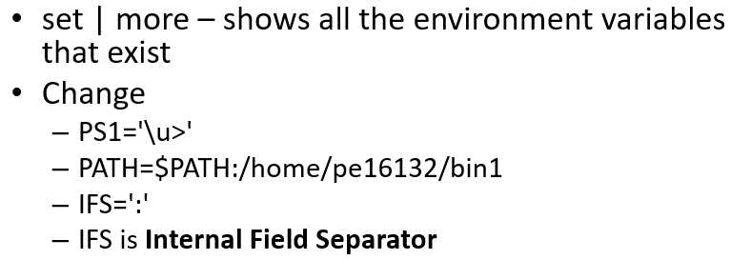
Environment variables

Slide 6
For loop in bash
Loop through a list – like java for each loop
for variable in wordlist
do
command(s)
done
variable will take on the value of each of the words in the list.

Slide 7
While loop in bash
The while command evaluates the command following it and, if its exit status is 0, the commands in the body of the loop are executed.
The loop continues until the exit status is nonzero.
Format:
while command
do
command(s)
done

Slide 8
Case Statement
If/elif/else construct
Syntax:
case variable in
value1 )
commands
;;
value2 )
commands
;;
) #default
Commands
;;
esac

Slide 9

Any input from your side?

Slide 10
Tasks
Write a script that would ask user to enter marks in specified subject and calculate it’s grade. You can create multiple scripts inside one script.
Write a script to implement the functionalities of calculator. You can create multiple scripts inside one script.

